Slide 1
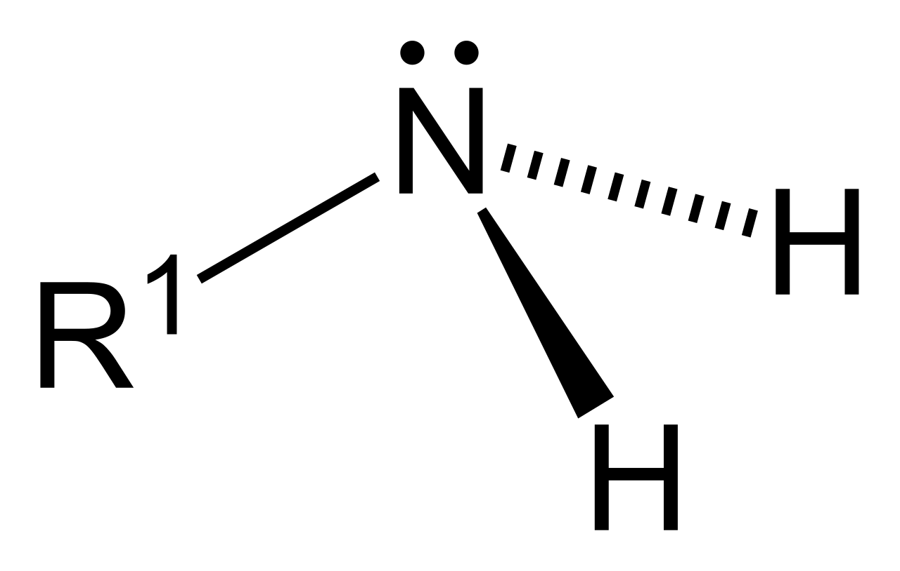
AMINES

Slide 2
PYRAMIDAL STRUCTURE OF AMINE
Sp3 hybridised nitrogen orbitals with bond angle 1080

Slide 3
Amines are formally derivatives of ammonia, wherein one or more hydrogen atoms have been replaced by a substituent such as an alkyl or aryl group (these may respectively be called alkyl amines and aryl amines; amines in which both types of substituent are attached to one nitrogen atom may be called alkyl arylamines).

Slide 4
Amine Structure
Nitrogen has 5 valence electrons and so is trivalent with a lone pair. As per VSEPR theory, nitrogen present in amines is sp3 hybridized and due to the presence of lone pair, it is pyramidal in shape instead of tetrahedral shape which is a general structure for most sp3 hybridized molecules. Each of the three sp3 hybridized orbitals of nitrogen overlap with orbitals of hydrogen or carbon depending upon the configuration of amines. Due to the presence of lone pair, the C-N-H angle in amines is less than 109 degrees which is a characteristic angle of tetrahedral geometry. The angle of amines is near about 108 degrees

Slide 5
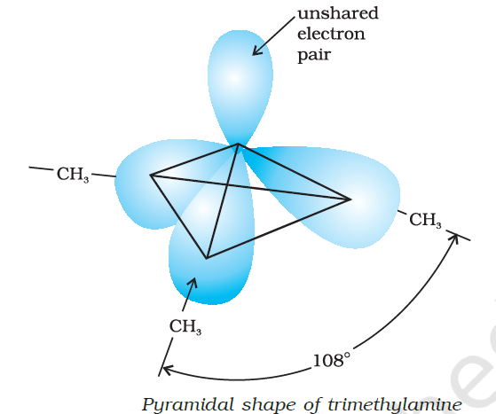

Slide 6
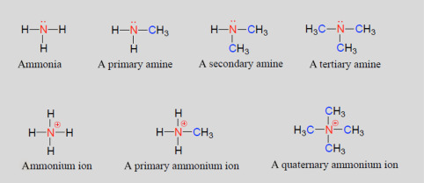

Slide 7
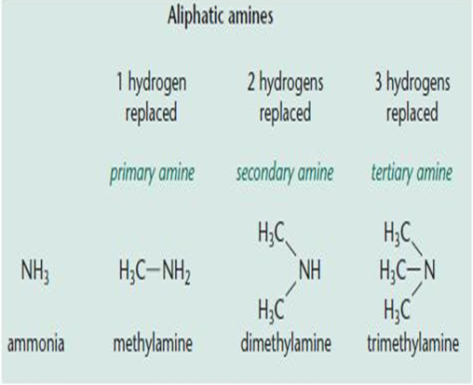

Slide 9
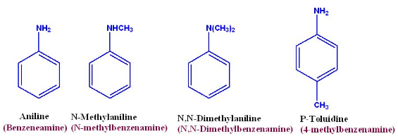

Slide 10
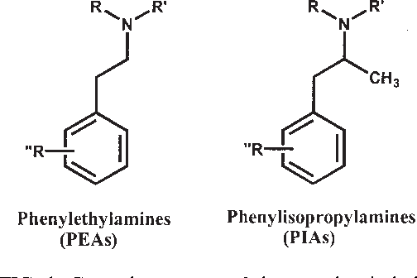

Slide 11
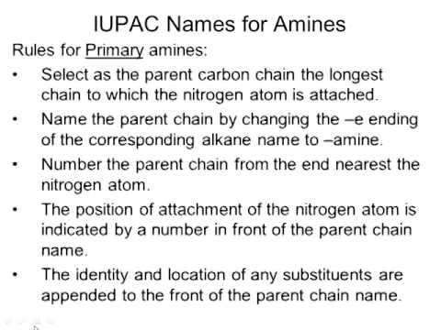

Slide 12
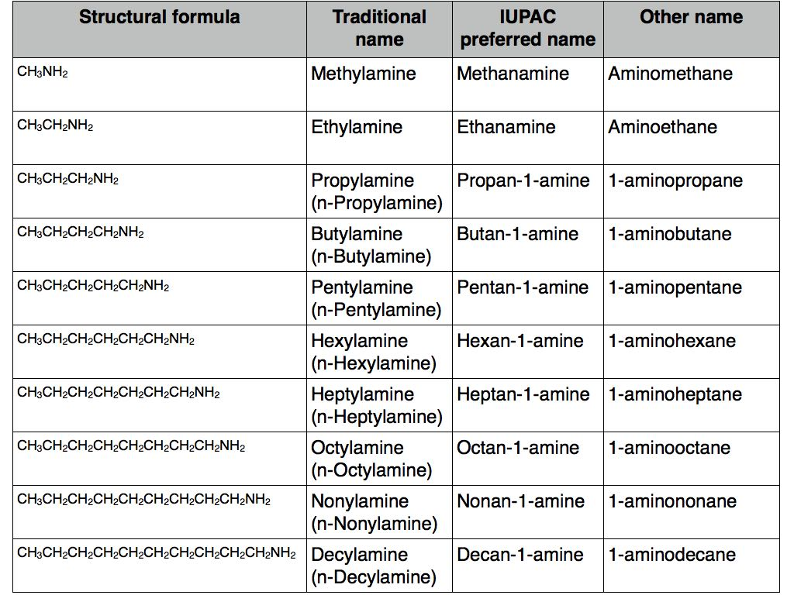

Slide 13
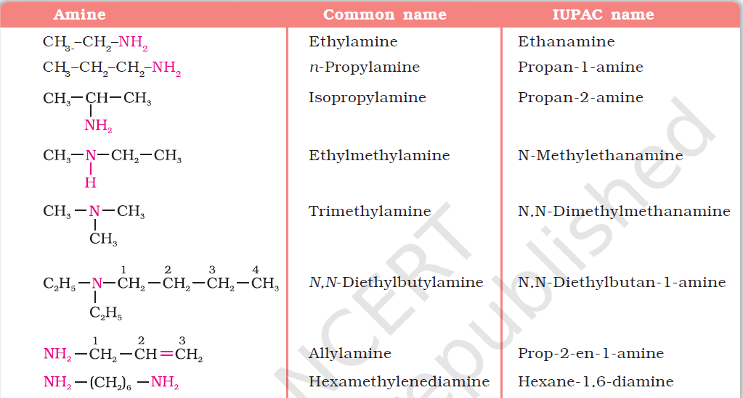

Slide 16
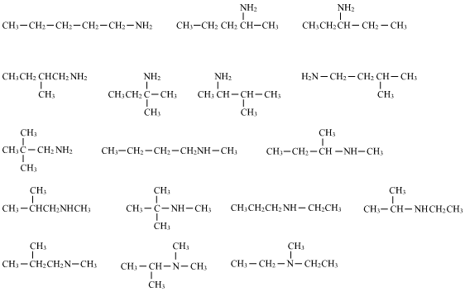
ISOMERISM IN AMINES

Slide 17
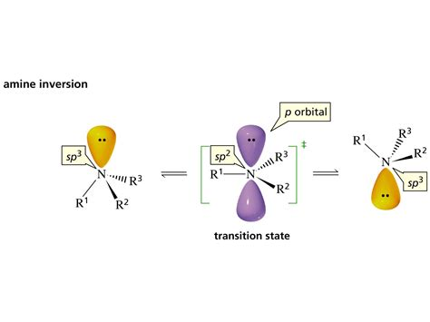
OPTICAL ACTIVITY IN AMINES

Slide 18
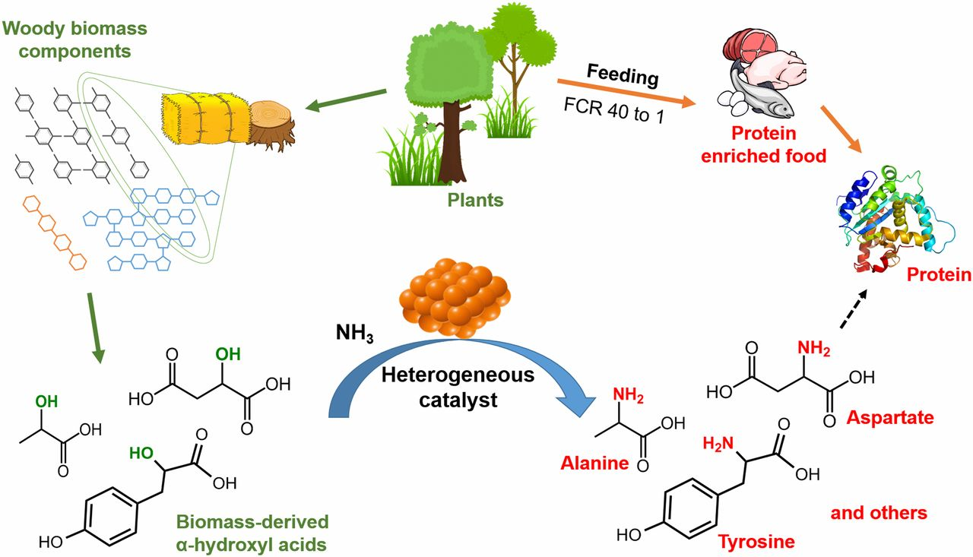
PREPARATION OF AMINE

Slide 19
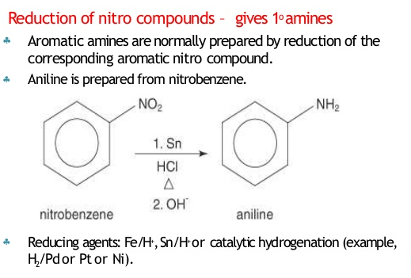
Reduction with iron scrap and hydrochloric acid is preferred because FeCl2 formed gets hydrolysed to release hydrochloric acid during the reaction. Thus, only a small amount of hydrochloric acid is required to initiate the reaction.

Slide 21
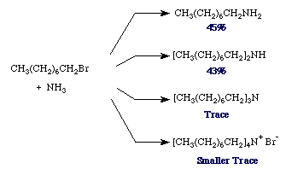
FROM ALKYL HALIDE
HOFFMANN’S AMMONOLYSIS

Slide 23
Method is for the preparation amine one carbon mre than the starting nitrile

Slide 25
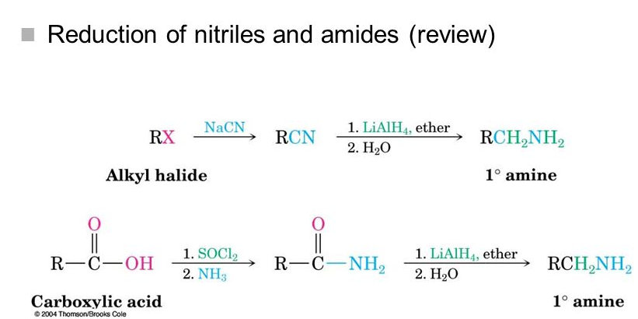

Slide 26
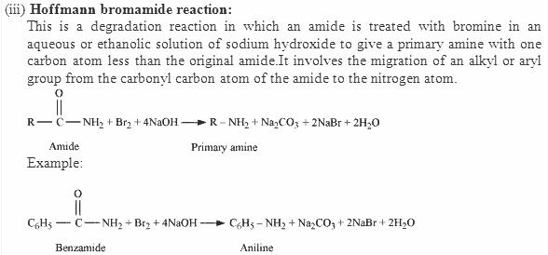

Slide 27
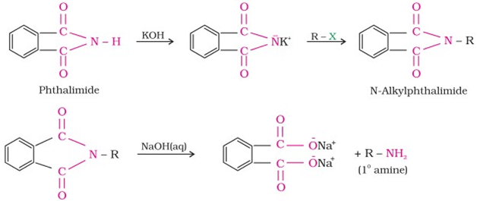
GABRIEL PHTHALIMIDE SYNTHESIS

Slide 28
PHYSICAL PROPERTIES OF AMINE
STATE AND ODOUR
The lower aliphatic amines are gases with fishy odour.
Primary amines with three or more carbon atoms are liquid and still higher ones are solid.
Aniline and other arylamines are usually odourless but get coloured on storage due to atmospheric oxidation.
SOLUBILITY
Lower aliphatic amines are soluble in water because they can form hydrogen bonds with water molecules.
However, solubility decreases with increase in molar mass of amines due to increase in size of the hydrophobic alkyl part.
Higher amines are essentially insoluble in water.

Slide 29
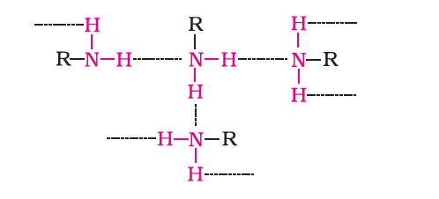
BOILING POINT
Primary and secondary amines are engaged in intermolecular association due to hydrogen bonding between nitrogen of one and hydrogen of another molecule.
This intermolecular association is more in primary amines than in secondary amines as there are two hydrogen
atoms available for hydrogen bond formation in it.
Tertiary amines do not have intermolecular association due to the absence of hydrogen atom available for hydrogen bond formation.
Therefore, the order of boiling points of isomeric amines is as follows: Primary > Secondary > Tertiary

